Slide 1
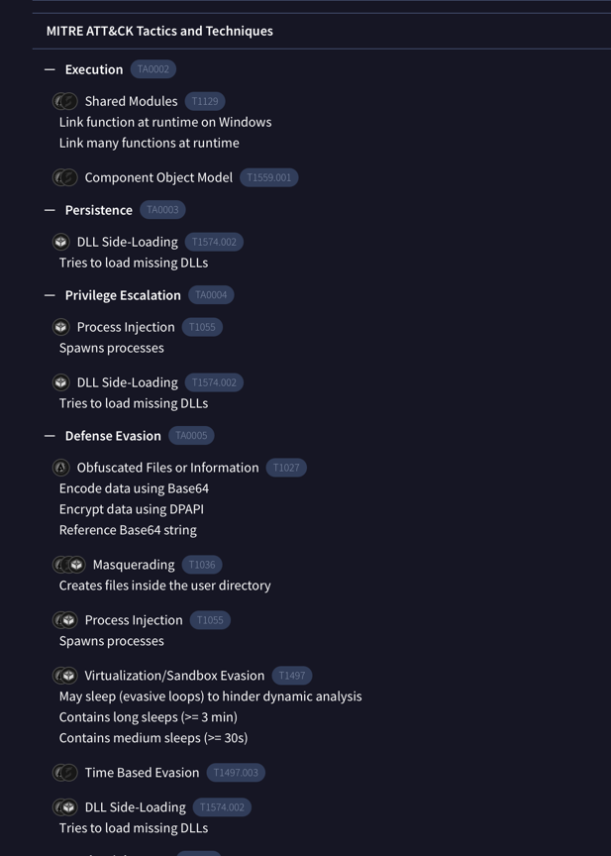
Has this file been identified as malicious? Explain why or why not.
Flagged as Malware by Virus Total.

Slide 2
TTPs
Tools
Network/host artifacts
Domain names
IP addresses
Hash values

